Slide 1
More SQL: Complex Queries
Ch: 05

Slide 2
More Complex SQL Retrieval Queries
Additional features allow users to specify more complex retrievals from database:
  Nested queries
  JOINS
  Aggregate functions
  Grouping

Slide 3
Nested Queries
Nested/Sub queries
  A query within a query
  Useful when condition has to be applied against an unknown value
Comparison operator IN
  Complete select-from-where blocks within WHERE clause of another query called Outer query
  Compares value v with a set (or multiset) of values V
  Evaluates to TRUE if v is one of the elements in V

Slide 4
Nested Queries Example (1)
Example: Retrieve the name and address of all employees who work for the ‘Research’ department.
  SELECT Fname, Lname, Address
  FROM Employee
  WHERE Dno IN (SELECT Dnumber
  FROM Department
  WHERE Dname='Research')
Sub query executed one time before the outer query
May return single attribute and single tuple or multiple
Output is temporary dataset used by outer query

Slide 5

Nested Queries Example (2)
Retrieve project no of ‘smith’ where he worked as manager or worker
SELECT DISTINCT Pnumber
FROM PROJECT
WHERE Pnumber IN
( SELECT Pnumber
FROM PROJECT, DEPARTMENT, EMPLOYEE
WHERE Dnum=Dnumber AND mgrssn=Ssn AND Lname='Smith' )
OR Pnumber IN
        ( SELECT Pno
        FROM WORKS_ON, EMPLOYEE
        WHERE Essn=Ssn AND Lname='Smith' );

Slide 6
Nested Queries (Tuple of values)
Can use Tuples of values in comparisons
  Place them within parentheses
Example: Retrieve Essn of all employee who work in same (Project,Hour) combination on some project that employee whose ssn= ‘12345678
SELECT DISTINCT Essn
FROM WORKS_ON
WHERE (Pno, Hours) IN ( SELECT Pno, Hours
FROM WORKS_ON
WHERE Essn='123456789');
Notes:
In this example, the IN operator compares the subtuple of
values in parentheses (Pno, Hours) within each tuple in WORKS_ON with the set of
type-compatible tuples produced by the nested query.

Slide 7
Nested Queries (Comparison Operator)
Other comparison operators instead of IN can be:
  ANY or SOME operator returns TRUE if the value v is equal to some value in the set V and is equivalent to IN.
  Other operators that can be combined with ANY (or SOME) include >, >=, <, <=, and <>
  The keyword ALL can also be combined with each of these operators.
Example : Returns the names of employees whose salary is greater than the salary of all the employees in department 5:
SELECT Lname, Fname
FROM EMPLOYEE
WHERE Salary > ALL ( SELECT Salary
FROM EMPLOYEE WHERE Dno=5 );

Slide 8
Correlated Nested Queries
Nested query could be
  Independent: Nested query evaluated once and result return to outer query
  Inner query is independent
  All previous examples independent inner query
  Correlated:
  Inner query is not independent
  Evaluated once for each tuple in the outer query

Slide 9
Nested Correlated Query Example
Retrieve the name of each employee who has a dependent with the same first name and is the same sex as the employee.
      SELECT E.Fname, E.Lname
      FROM EMPLOYEE AS E
      WHERE E.Ssn IN ( SELECT Essn
      FROM DEPENDENT AS D
      WHERE E.Fname=D.Dependent_name
      AND E.Sex=D.Sex );
Avoid potential errors and ambiguities
  Create tuple variables (aliases) for all tables referenced in SQL query

Slide 10
The EXISTS and NOT EXIST
EXISTS and NOT EXISTS
  Check whether the result of a correlated nested query is empty or not
  Typically used in conjunction with a correlated nested query
Query: Retrieve the name of each employee who has a dependent with the same first name and is the same sex as the employee
SELECT E.Fname, E.Lname
FROM EMPLOYEE AS E
WHERE EXISTS ( SELECT * FROM DEPENDENT AS D
WHERE E.Fname=D.Dependent_name AND E.Sex=D.Sex AND E.ssn=D.essn );
Query : Retrieve the names of employees who have no dependents.
SELECT Fname, Lname
FROM EMPLOYEE
WHERE NOT EXISTS ( SELECT *
FROM DEPENDENT
WHERE Ssn=Essn );

Slide 11
Accessing Multiple Tables
Cartesian Product
Inner join
Natural Join
Outer Joins

Slide 12
Cartesian Product
No specific command, Simply use:
  SELECT command without specifying WHERE clause
Resultant table :
  Cardinality (no. of rows): m x n rows
  Degree (no. of Attributes): m+ n Attributes
Example:
    SELECT * FROM Employee, Department
    SELECT * from program, course

Slide 13
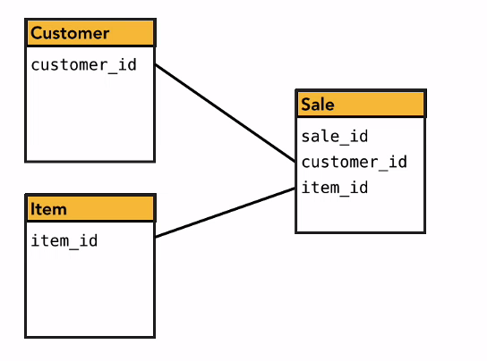
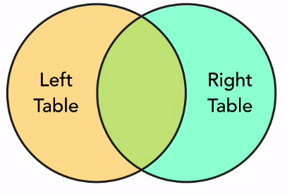
Table Relationship
Some table contain information related to other tables
  Using Join statement SQL is powerful tool to extract related data from multiple tables
  The intersection of shape where record overlap or condition is match
  Id field is often use where condition to be match
Left.Id= Right.Id

Slide 14
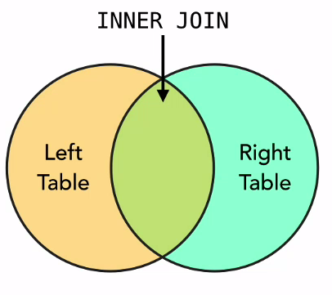
INNER JOIN
The result of inner join includes row from both table where join condition is met (equi Join)
  Default type of join in a joined table
  Tuple is included in the result only if a matching tuple exists in the other relation
SELECT Fname, Lname, Address
FROM (EMPLOYEE JOIN DEPARTMENT ON Dno=Dnumber)
WHERE Dname=‘Research’;
SELECT Fname, Lname, Address
FROM (EMPLOYEE INNER JOIN DEPARTMENT ON Dno=Dnumber)
WHERE Dname=‘Research’;

Slide 15
NATURAL JOIN
NATURAL JOIN on two relations R and S
  No join condition specified
  Implicit EQUIJOIN condition for each pair of attributes with same name from R and S
  SELECT Fname, Lname, Address
  FROM (EMPLOYEE NATURAL JOIN DEPARTMENT)
  WHERE Dname=‘Research’;

Slide 16
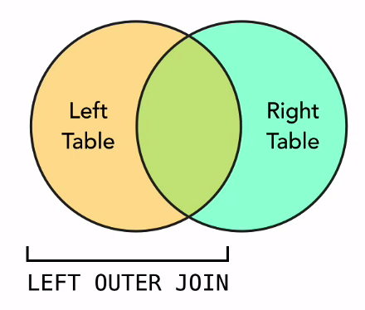
LEFT OUTER JOIN
Includes rows where condition is met + All the rows from left where condition is not met
Syntax:
SELECT*
FROM table_name
LEFT OUTER JOIN Table_name
ON (Predicate)

Slide 17
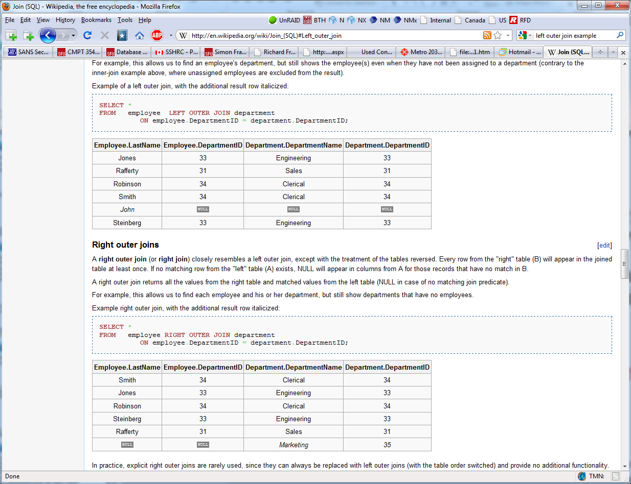
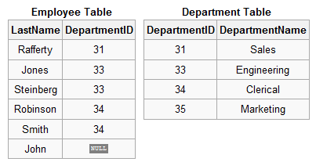
Left Outer Join Example

Slide 18
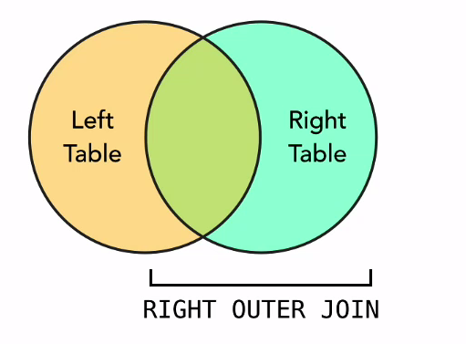
RIGHT OUTER JOIN
Includes rows where condition is met + All the rows from right table where condition is not met
Syntax:
SELECT*
FROM table_name
RIGHT OUTER JOIN Table_name
ON (Predicate)

Slide 19
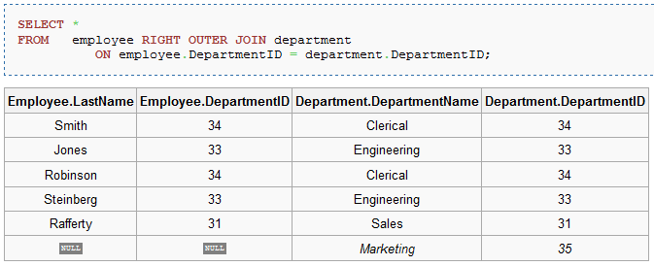
Right Outer Join Example
Notes:
Sure, just need to change order.

Slide 20
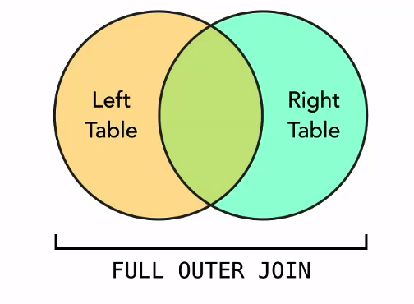
FULL OUTER JOIN
All rows from both table + rows where condition is met
Syntax:
SELECT*
FROM table_name
FULL OUTER JOIN Table_name
ON (Predicate)

Slide 21
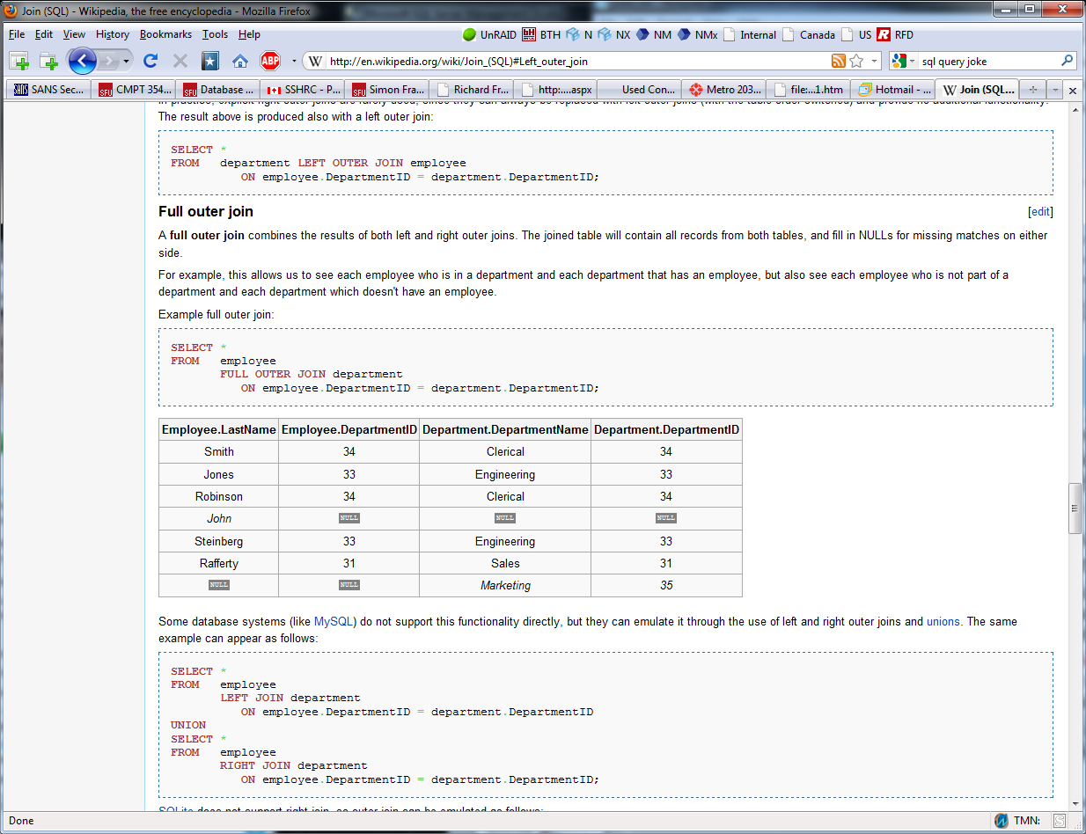
Full Outer Join Example

Slide 22
Aggregate Functions in SQL
Aggregate data is information derived from more than one row at a time
  Used to summarize information
  Operate on a set of rows and return a single value, like, AVG, SUM, MAX, MIN, STDEV, COUNT
Grouping is used to create subgroups of tuples before summarization.
Functions can be used in the SELECT clause or in a HAVING clause

Slide 23



Aggregate Functions: Examples
Query: Find the sum of the salaries of all employees, the maximum salary, the minimum salary, and the average salary.
  SELECT SUM (Salary), MAX (Salary), MIN (Salary), AVG (Salary) FROM EMPLOYEE;
Query: SELECT COUNT (*) AS TotalEmp
  FROM EMPLOYEE;
Query: SELECT COUNT (DISTINCT Salary) As DISTINCTSalary
  FROM EMPLOYEE;

Slide 24
GROUP BY
GROUP BY clause
  Specifies grouping attributes
  Partition relation into subsets of tuples based on grouping attribute(s)
  Aggregate functions (like SUM) return the aggregate of all column values every time they are called, and without the GROUP BY function it is impossible to find the sum for each individual group of column values.
  Apply function to each such group independently
  Syntax: SELECT column1, column2, ... column_n, aggregate_function (expression)
  FROM tables WHERE predicates
  GROUP BY column1, column2, ... column_n;

Slide 25
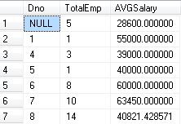
GROUP BY: Example
If NULLs exist in grouping attribute
  Separate group created for all tuples with a NULL value in grouping attribute
Query: For each department, retrieve the department number, the number of employees in the department, and their average salary.
  SELECT Dno, COUNT (*) AS TotalEmp, AVG (Salary) AS AVGSalary
  FROM EMPLOYEE
  GROUP BY Dno;

Slide 26
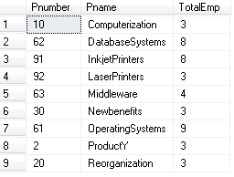
HAVING Clause
HAVING Clause
  Restrict groups by satisfying having condition will be selected
  Provides a condition on aggregate data
  WHERE clause provide condition on non aggregate data(rows)
Example: For each project on which more than two employees work, retrieve the project number, the project name, and the number of employees who work on the project.
  SELECT Pnumber, Pname, COUNT (*) AS TotalEmp
  FROM PROJECT, WORKS_ON
  WHERE Pnumber=Pno
  GROUP BY Pnumber, Pname
  HAVING COUNT (*) > 2;

Slide 27

Discussion and Summary of SQL Queries

